Slide 1
EMDM Single Master Proposal
EMDM , ZYME, GSD, SPT, Deal Sync.
Jul 06, 2020

Slide 2
Agenda
Current flow Vs proposed flow
EMDM Timelines
Risks/Open Questions
Next Steps

Slide 3
Requirements
# No. | Requirements | Deloitte Comments | Open Items/Not in Scope/Closed
1 | MDCP incremental should be stopped and this should not increase the TAT of data flow to downstream or the TAT provided to downstream for transactions’ creation or E2E connectivity | Do not expect increase in TAT, to downstream. Ex : CRS & SRS stopping reduced the performance issues | Closed
2 | Both Internal and External Parties should be in scope for the replacement of MDCP incremental retirement | Yes, both are in scope | Closed
3 | Retirement of MDCP incremental should not generate creation of duplicates | BP ID churns will reduce & unnecessary match through batch will reduce. However, we are planning to use ProcessEDIOrder (CPQ Deal sync) which is better match rule then batch load | Closed
4 | Each Party in EMDM that has a role should have a unique OPS/OPSI associated when incremental is stopped (except the Public Sector duplicate situation where we have a DUNS Party and Internal Party as intended duplicates) | Analysis : 140k parties with role in EMDM are still without OPS/OPSI Scenarios 1 : OPS Fallout Scenarios 2 : MDAS Queue Mihaela to check with EMDM Ops Team/EMDM Operate team | Closed
5 | Retirement of MDCP incremental should not negatively impact EMDM/MDCP performance | No, It will not negtively impact the performance | Closed
6 | For OM Fusion, PN – they should do XREF MDM lookup first before doing a match on Name + Address match (this is regarding the current MDAS process) | Mihaela to check with YoYo for additional details. Mihaela to check by 08/27 | Open Item
7 | Systems/Assets that need a Party ID should call EMDM; if Party not found in EMDM, we leverage existing alignment/creation services in EMDM. We need sources that are adding Tasks under Candidate Resolution to have distinct names specific to each Source System. All Tasks with details should be exportable.We need details by system/group (Zyme, SFDC, GSD, CPQ etc) | Boundary apps will call EMDM as aligned. Ex : Zyme will use the daily subscription process & CPQ deals will invoke the ProcessEDIOrder API. GSD & SPT alignment pending. ETA : 08/28 | Open Item

Slide 4
Requirements – Continue Slide 4
# No. | Requirements | Deloitte Comments | Open Items/Not in Scope/Closed
8 | Auto subscription to be implemented when Parties are created from Candidate Resolution tasks. Subscription should be aligned to Source. If Source is Zyme, subscription should be Sales Out | Mihaela will check with Minakshi | Open Item
9 | Ask on Cand Resolution: when we create DUNS Parties, if the DUNS Party already exists, we should not create a duplicate one. We should leverage the existing DUNS Party. It should only need to update history with the resolution decision with the existing DUNS Party Id | Should not be in scope for this Object, Just for tracking from Biz side | Closed
10 | Ask on Cand Resolution: when we create/standardize Parties we should be able to change type from Individual to Org or vice versa | Already handled as part of RICEF Object EMDM 488 & 578 . | Closed
11 | Ask on Cand Resolution/EDI Candidate Resolution: any Party ID that is created/standardized needs to be sent back to the requestor (source) | Handle this in Candidate resolution enhancement but should not be part of this Object - Not in Scope | Closed
12 | We need to be able to add Party Association in bulk with a Data Loader | In scope but not for November (Aligned with Ben & Mihaela) | Closed
13 | For Zyme benefit: we need E2Open to start using Advance Match, use Maintain/EDI service and add process usage to Party | In scope to ensure all E2open records will have subcription, So that it will get the OPS/OPSI via bridge 11 | Closed

Slide 5
Requirements – Continue Slide 4
14 | For CPQ: for the non deployed countries that are still using OPSIs, they should use the S4/EMDM XREF to get the Party ID + Association. If Party does not exist, Party should be created via existing alignment/creation services in EMDM or as Internal (would go to Candidate Resolution tasks or SFDC case? TBD) | Not in scope for EMDM deloitte . Onboarding support Ben will share the design details on the new XREF service | Closed
15 | If any BOT is involved in the solution, the BOT should not impact performance of EMDM | Not in scope for deloitte, Just for tracking from Biz side | Closed
16 | If any BOT is involved in the solution, the BOT can use Association service to maintain the XREF (MDCP/EMDM: each Party ID should have an OPS, OPSI against it in EMDM and SFDC.) – basically replacing Sync18 | Not in scope for deloitte, Just for tracking from Biz side | Closed
17 | If any BOT is involved in the solution, the BOT should add both EMDM subscription process, and MDCP usage tags on: Party IDs, MDCP IDs. (to check with Jerada if in scope for BOT, if not we need new solution) | Not in scope for deloitte, Just for tracking from Biz side | Closed
18 | The BOT should not create duplicates, either at PA level, XREF level, Party level | Not in scope for deloitte, Just for tracking from Biz side | Closed
19 | Fix MDAS match logic (SD ID to be provided) | Not in scope for deloitte, This should owned by DXC as the fix needs to be addressed in MDAS. Fix before Nov 2020 | Closed

Slide 6
Requirements – Continue Slide 4
20 | Anything on the numbers of retries for Bridge 11? | Should not be in scope for deloitte [Akshat/Ashraf] | Discussion Pending with Mihaela, discussion to happen on 08/27
21 | We need to collect requirements from Partner, Hierarchy, Contact POD | Should not be in scope for deloitte [Akshat/Ashraf] | Discussion Pending with Mihaela, discussion to happen on 08/27
22 | NGQC/AOE is calling MDCP today for Order Ready – for OPSI to CRS creation. What will happen when incremental is stopped? Proposal from IT? (Yoyo) | Not in scope for deloitte as we are not changing anything in CRS & MDCP [Akshat/Ashraf] | Discussion Pending with Mihaela, discussion to happen on 08/27
23 | 360 Service – OPSIs can be associated to CRS so that PN contract is associated to SFDC Opportunity. What will happen when incremental is stopped? Proposal from IT? (Yoyo) | Not in scope for deloitte as we are not changing anything in CRS & MDCP [Akshat/Ashraf] | Discussion Pending with Mihaela, discussion to happen on 08/27
24 | We need confirmation on requirements from SFDC, CPQ biz | CPQ - Done, SFDC - Pending, ETA - 08/27 | Discussion Pending with Mihaela, discussion to happen on 08/27
25 | We need confirmation on the requirements from E2Open biz | Done | Discussion Pending with Mihaela, discussion to happen on 08/27
26 | We need confirmation on the requirements from GSD biz | GSD - Pending, ETA - 08/27 | Discussion Pending with Mihaela, discussion to happen on 08/27
27 | Review BOT when ready in UAT | It should not impact anything on MDCP retirement | Discussion Pending with Mihaela, discussion to happen on 08/27
28 | MDM Ops will demo to IT a Sync18 case | Demo Done | Discussion Pending with Mihaela, discussion to happen on 08/27
29 | XREF to be flown in subscription instead of 1.x incremental pipeline |  | Discussion Pending with Mihaela, discussion to happen on 08/27
30 | New requirement due to 611. To enhance UI at cross reference level for both HPS and MDCP. Currently only accommodates CRS, SRS and PMG. Missed in original requirement. Need to support Migrations timely. Mihaela: This should be logged under EMDM as Master MDCP, not as separate CCB. | Analysis : Please check below parties in Prod, all are showing the HPS & MDCP legacy ID in cross ref tab 1000760607 1000693210 1000699769 1000806701 1033250542 | Discussion Pending with Mihaela, discussion to happen on 08/27

Slide 7
Current PARTY FLOW
Search, subscription & maintain API
SPT
GSD
HPEFS
Retires July 2020
Party Creates
Party
UVAs
Manual Sync 18
Via Ticket Process
MDCP
Party
EMDM
Bridge 11
ZYME
Party Lookup
OPSI Creation
Deals
eclipse
Deal Sync (IF) - bridge 12
S4
600 deals a day
Notes:
Scope and out-of-scope view (In Scope: MDCP Party , GSD UVAs; Not In Scope: MDCP Locations)
Data Recon reports
OM Flows & MDAS
Sales Territory
QYP
HPEFS
CPQ / Eclipse
SalesForce SPT Flow
SalesForce GSD Flow

Slide 8
Proposed PARTY Flow
Un Aligned – Ticketing Process
SPT
Current: Search, subscription & Maintain Web service
Proposed : Use the existing process (Bridge 11). No impact on SPT & GSD
Please see slide
GSD
Current: Ticket Process
Proposed : Use the existing process (Bridge 11). No impact on SPT & GSD . Please see slide
SPT
ZYME
GSD
Party
Aligned Party - UVAs
Sales Territory
Retires Nov 202
Stop Party Flow
HPEFS
MDCP
EMDM
Deal Sync
Current: Party Lookup + Ticket Fall out process
Proposed: Local Party Lookup,
EMDM – Process EDI Order API & Party Association
(Name need to be changed)
Bridge 11
OPSI Creation
Deal Sync (IF) - bridge 12
eclipse
OPSI Info
+ Deals
S4
600 deals a day
Notes:
UVA process – reduced volume ? (Before and after process in context of Location and Party process)
Current : UVA & UVL is created via GSD process . (Current UVA volume from the Queue)
Future: UVA volume will reduce, UVL stopped (No touch api).
Scope and out-of-scope view (In Scope: MDCP Party , GSD UVAs; Not In Scope: MDCP Locations)
Data Recon reports
OM Flows & MDAS
Sales Territory
QYP
HPEFS
CPQ / Eclipse
SalesForce SPT Flow
SalesForce GSD Flow

Slide 9
CPQ deals current vs proposed steps
Current Flow:
Deals Creation in eclipse and tagging of OPSI in MDCP
Once deal created, Via Bridge 12 it will reach to S4 via IF through SFTP
Incremental run from MDCP-> EMDM, will create Party for OPSI or tag OPSI with party (based on Match/No Match) in EMDM
S4 Cross ref to check Party ID locally, involves local party lookup (if not found) then call EMDM to get party linked with that OPSI else ticket fallout process
S4 Create deals once getting the Party ID
Proposed Party flow :
Deals Creation in Eclipse and tagging of OPSI in MDCP
Once Deal created, Via Bridge 12 it will reach to S4 via IF through SFTP
S4 Cross ref to check Party ID locally
If not found, then call EMDM to get Party ID or create Party ID (Process EDI Order) and align XREF by invoking EMDM API (Net New). Please see slide
After creation of party ID, if the deals fallout then retry mechanism should be in place
S4 Create deals once getting the Party ID
Notes:
- Biz req from CPQ: S4 cross ref should be aligned to mergers, meaning M&M should update the cross ref table – Loser OPSI should rollup to Winning Party, no longer the Losing Party
- Biz req from CPQ: KNA1 table to be in Sync with EMDM Party info
- Ana: when do we have Association in place for Partners? Also the same q for subscription, creation on the fly
- Mihaela: search on Name + Address

Slide 10
MDCP Current EMDM Flow
Sathish
Daily Incremental for MDCP
Expected Volume : 300 to 400 approx.
Expected Duration : ~4 hours
Schedule 4:00 pm CST
What are the filters – Refer to Slide 37
MDCP
Match and Merge
CRS
EMDM Stage
EMDM
SRS

Slide 11
Current spt flow
Current Flow for Customer : SFDC is calling EMDM Search, and then if not found in EMDM use Maintain to search against DNB
Step 1 : SPT create the party - EMDM - SFDC
Search - Search against EMDM with /Search
Subscribe - If found subscribe with /subscription
Maintain - If not found ability to expand search to DNB (we don't call DNB directly as costing each call + we need more fields via /Maintain than with /search)
if found in DNB, self creation and subscription via /Maintain
Case creation : if not found in DNB, user can log an Account Request case to EMDM Ops team
Step 2: Customer record created with party ID and no MDCP ID, - SFDC Support case created for EMDM ops - SFDC
Step 3 : Sync 18 EMDM Ops is finding or creating record in MDCP and subscribing it - MDCP
Step 4 : Copy back the OPS/OPSI from MDCP to salesforce – MDCP-SFDC
Step 5 : MDCP incremental flow is adding the OPS/OPSI subscribed to EMDM Party Assc.(this need to changed) – MDCP - EMDM

Slide 12
Boundary app teams to INTEGRATE WITH EMDM
Scope | Type | Application | Summary | Status | Alignment on solution | Action Item
Zyme to integrate with EMDM & MDCP | Integration | Zyme | E2Open to use the daily subscription file implemented in April. Please see slide 19 & 20 | Use existing integration. Effort level: Low. Estimate : $107,670 | Yes High Estimation and not aligned with timeline | Sunitha to review the estimates & align E2Open on timelines
GSD to integrate with EMDM | Integration | GSD | BOT for sync 18 is still in dev and go live in September. Sep go Live Bot will only helpful for Manual sync 18 and not dependent on retirement of incremental flow. Please see slide 15 | GSD prefers existing UVA/OPS process. GSD to integrate with EMDM in LR1.7 then UVA volume will decrease | WIP, there will no gap when we will stop the flow as they are not align with Nov timeline. | Align GSD/SPT on the existing process. Call scheduled for 08/27
SPT to integrate with EMDM | Integration | SPT |  | If EMDM business OPS can handle the additional backlog, then they are fine. BOT release date for Sync 18 - September. (NO SCOPE FOR IT)
HPEFS to retire flow | Integration | HPEFS | Retire the flow from HPEFS to MDCP | HPEFS is fine if bridge 11 is working and they can get sales territories and segments from legacy MDM | Yes, No Change needed Received response from Ravinder Singh | NA
Deal Sync to integrate with EMDM | Integration | Eclipse, CPQ deals | Deal Sync to invoke EMDM’s Touchless Party Creation and XREF association. Net New : Invoke Process EDI Order Invoke new microservice for setting up the XREF | Efforts : 120 hrs. Estimates : $5952 | Yes, Received response from Cathy & Punit | Sunitha to review the estimates. Awaiting Data points from eclipse team.
Sales Territory - QYP Process | Data Points | EMDM | Assumption: Bridge 11 is needed | Jane confirmed this is okay but needs a solution to address an existing gap. (NO SCOPE FOR IT for EMDM as Master, solution for QYP need to be provided by talking to Cross PODs) | Yes Received response from Jane | NA
Enable OPSI Creation API | Service | MDCP | Expose MDCP OPSI Creation API | Not Required | NA | NA
Notes:
- Why do GSD’s need Legacy MDCP ID past September ?
- Volume of GSD Accounts that is used by SPT need to be determined.

Slide 14
Option 1 :
Option 2 :
EMDM
Bridge 11
MDCP
Bridge 11 & Manual Sync 18 will take care if we will stop incremental for GSD & SPT
Party created in EMDM via MaintainAPI
5) Invoke EMDM cross ref. API to create association + XREF - New service
EMDM
Stop Party Flow
Pros : No change required for SPT & GSD, existing bridge, Effort level : Low.
Bridge 11 is quick for duns aligned party as real time call already happens to MDCP
Cons : TAT is more at least 24 hours. Pricing type scenarios need to be done in 2 hours. If party is internal then it can take up to 7 days.
MDCP subscription constraints (Isabelle/Mihaela to confirm) . We cannot always subscribe
the OPSI we want as there is a limitation to 1 OPSI by ORG . Bridge 18 can handle
Bridge 11 will not do the XREF association (that is not needed, not visible to anyone)
Pros : TAT is quick – for pricing type scenarios
No misalignment of Party & OPSI
Performance wise it is better than Option 1
Cons : Effort estimate on both EMDM & (SPT/GSD)
Need to stop bridge 11 process for SFDC created parties
Notes:
Option 1 : Bridge 11
Option 2 : Invoke EMDM cross ref API to create association
Why Option 1 is not feasible ?
Real time call with MDCP is quick for duns Aligned parties
Records in Queue (Error records (duns aligned parties + Internal sourced parties)) will get the OPS/OPSI in 24 hours if OPSI created in MDCP via manual sync 18 process within 24 hours.
Also, If OPSI created in MDCP via manual sync 18 in more than 24 hours then invoking new service will anyways take more then 24 hours to create cross ref in EMDM
Pricing type scenarios will complete its course in 2 hours but is there any issue if that association is created in EMDM in 24 hours ? TAT ? Any thing else

Slide 15
E2e opsi flow oppty to quote – SPT/GSD
Bridge 11
MDCP
Party ID – 1000111111
OPSI - 100000005
Sync 18/SFDC
EMDM
Party Creation
&
Subscription
MDCP OPSI Identification
Creation
Subscription
Add BR ID Click MDCP Sync
NGQ
NGQC
Party ID - 1000111111
Party ID – 1000111111
OPSI - 100000001
Party ID – 1000111111
OPSI - 100000001
EMDM Party Association
Party ID – 1000111111
OPSI – 100000005
OPSI – 100000001
Today
Tomorrow
MDCP Incremental
Create Association Manually
(Ops Process)
Create Association API
This complements Bridge 11 when:
the DUNS does not exist in MDCP
if Bridge 11 alignments take additional time
If Bridge 11 aligns to a different OPSI
This also replaces the manual Party association process executed today in order to expedite the associations in EMDM.
Ensures that the OPSI on the transaction is aligned in EMDM prior to Opportunity load in NGQ
OPSI - 100000001
Party ID – 1000111111
OPSI - 100000001

Slide 16
Spt current flow
Current process on GSD Account Request Cases
Account Request case is assigned to MDM Ops – SFDC
MDM Ops only subscribes the MDCP OPSI (Opportunity Management & Service Delivery)- they can only subscribe 1 OPSI per Org. - MDCP
The MDCP Subscription triggers a party creation & party association – MDCP - EMDM
GSD has a program which queries OPSIs created in SFDC with no Party & refers to Party association table for the EMDM Party ID & inserts the Party ID on the customer record in SFDC – SFDC - EMDM
If step 3 no longer occurs above, the following would be the revised process for GSD UVA cases:
Account request case is assigned to MDM Ops – SFDC
MDM ops subscribes the EMDM the party if found - EMDM (Need to confirm)
An MDCP lookup case is assigned & MDM Ops subscribes the MDCP OPSI ID & manually adds to the customer record in SFDC (this is where the volume will increase) – MDCP - SFDC
In September
GSD will be able to self-subscribe customers using EMDM services but we will have some rules in place to subscribe the Identified Headquarter level instead of subscribing branch levels when not public sector accounts. (this is key to keeping the volume of accounts down for MDM Ops) – Will be same as SPT (Self subscribing to EMDM & D&B)
An MDCP lookup case is assigned & MDM Ops subscribe the MDCP OPSI & manually adds to the customer record in SFDC. - Manual Sync 18

Slide 17
HPE ACCOUNT TEAM AND RELATION WITH SALES TERITORY IDS
Here is a little write up on the HPE Account Team and its relation to Sales Territory IDs. In Release 1.7, we have changed our trigger logic and UI to use the Country and Global Entity IDs i.e. remove our dependency with Sales Territory:
HPE assigns an HPE Account Team i.e. Account Managers, Account Domain Managers, to Top Accounts.
A SFDC custom object called "HPE Account Team" creates a join between Account and HPE Account Managers (SFDC licensed user)
When an HPE Account Manager is added to an account, SFDC trigger logic "cascades" the manager to all the SFDC Accounts that share the same Sales Territory. User can limit the "cascade" to a single Account, the Country or Global territories.
When a new Account is subscribed in SFDC, triggers check if the Account is managed i.e. its Sales Territory ID appears on the "HPE Account Team" table. If Account is managed, the trigger automatically adds the corresponding HPE Account Team members to the new Account.
GSD has functionality to send notifications (email/chat) to HPE Account Team members. A notification can be send if a Support Case has been "elevated" i.e. problem is not resolved by call centers and requires product division assistance. This functionality allows HPE Account Team members to be "on top" of any service delivery bottlenecks as they directly interface with customers.

Slide 18
Zyme PROPOSED ARCHITECTURE
Advanced Matching
Partner capabilities via CPP
MDCP
(MDAS)
Batch API
Returns OPSI ID or creates ticket for MDCP
3rd
ZYME
Proposed
EMDM
(Adv Matching)
Channel Data
Current
Customer is automated in MDCP using the Adv Matching of MDCP
Reseller / Partner is fully Manual currently in MDCP
Future :
Matching for customer and Partner
Name +
Shipto Address
Sold to Customer
1 - (MaintainParty - Party ID)1st
2 - (Lookup - Siebel ID or OPSI ID)
3. Create OPSI
4. (Maintain XREF – Party ID & OPSI ID)
Zyme has a matching capability:
Notes:
Emmanuel + Mark.
Zeguer, Emmanuel <emmanuel.zeguer@hpe.com>

Slide 19
Zyme Integration – OPTION 4 (Enhance existing Integration) - SELECTED SOLUTION
3
Add OPSI Xref (Min),
Siebel ID (Publish All – Zyme to determine)
IF – Snap / EMDM Schedulers
File based
1
Zyme
EMDM
Channel Partner Data Collection System
2
Existing bridge 11
MDCP
Notes:
Zyme to determine the appropriate Siebel ID based on the BR. (Mark Fisher discussed with Emmanuel Z)
SLA – 3 days (Party ID fetched in the first day)
No Holding the file even if Siebel ID & OPSI ID is not present.

Slide 20
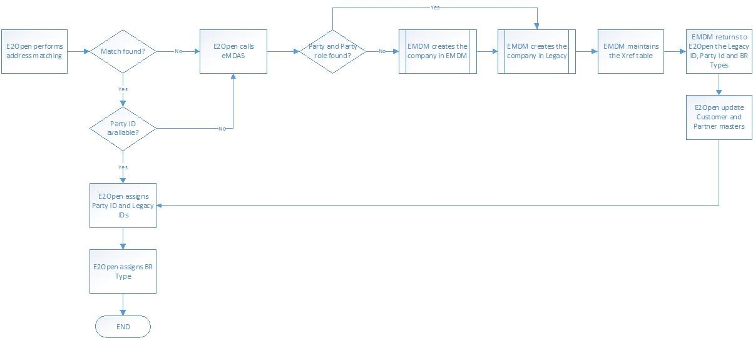
ZYME Aligned flow with e2Open - final
Notes:
When we are stopping the incremental flow how ZYME is affected, EMDM should be affected only as OPSI will be missing in EMDM
Zyme should continue the process they are having and EMDM can manage to get the OPSI via bridge 11 ? Confirm with Ben/Ashraf/Mihaela

Slide 21
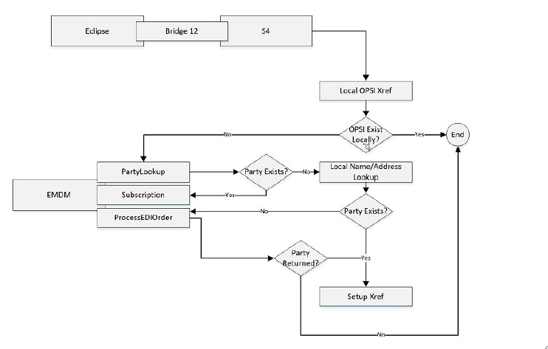
EMDM LOOK FOR CPQ DEALS
Net New
Notes:
Resolves CPQ tagging process.

Slide 22
APIS involved
API | Offered by | Invoked By
Create/Search Party | EMDM | Respective source system (like Zyme, SPT, etc)
Maintain OPSI to Party ID cross ref | EMDM | Respective source system (like Zyme, SPT, etc)
Get OPSI and Siebel ID for a Given Party | EMDM | Respective source system (like Zyme, SPT, etc)
Create/Search OPSI | MDCP (Proposed) | Respective source system (like Zyme, SPT, etc)
EMDM XREF Maintain | EMDM | Respective source system (like Zyme, SPT, etc)

Slide 23
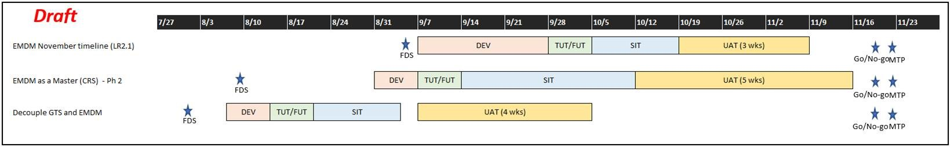
EMDM Timeline
# | Activity | Status | Start Date | End Date | Owner
1 | Cross- workstream alignment on high-level design | Open |  | 7-Aug | Sunita, Mihaela, Akshat, Ashraf, Other POCs
2 | Provide estimates per current high-level design | Open |  | 12-Aug | Deloitte, E2open, SPT, Others
Design
1 | Submit FDS | Open | 27-Aug | 31-Aug | Akshat
2 | FDS sign-off | Open | 31-Aug | 3-Sep | Mihaela, Beth
3 | Submit TDS | Open | 4-Sep | 15-Sep | Akshat, other downstream
4 | Sign-off TDS | Open | 15-Sep | 18-Sep | Sunitha, Parag

Slide 24
Next Steps
Reconnect to address open questions
Identify any risks/issues

Slide 25
Summary - gsd
They are fine with the existing UVA process (Manual ticketing process)
Bridge 11 with its current design is deemed sufficient to support the existing GSD UVA manual process, and provide the association of EMDM Party to the legacy MDCP information that are needed for GSD operations
Chia, Kok Meng <kok-meng.chia@hpe.com> from GSD confirmed on 07/09
At this point of time, we would like to have GSD to continue using existing/current manual process for UVA through Sep (LR1.7).
Reasons being:
Understanding from EMDM biz lead (who support this UVA process) that the existing/current manual process will still result in EMDM party creation and via Bridge 11, will associate OPS/OPSI with Party.
Understanding that the Bridge 11 operation is not dependent on the proposed automation. Bridge 11 operation can continue to work with the existing/current manual UVA process. This has been confirmed by both Deloitte and EMDM biz leads.
Many critical gaps in GSD -SF-EMDM integration (LR1.7) that require immediate attention and focus from biz/IT currently. We need to stabilize these LR1.7 GSD-SF-EMDM integration changes first, before adopting the proposed automation from Deloitte (possibly at a later release after LR1.7).

Slide 26
Summary - HPEFS
No Impact if Bridge 11 is working, and we are able to get Sales Territories and segments from Legacy MDM.
Switch to EMDM in HPEFS has happened on December 2019/early January 2020
In September/November of 2020, last piece of EMDMH integration is planned for go live (which gets feed for Territory and Segment)
HPEFS still getting both feeds from MDCP (for Sales Territory, segment etc) and from EMDM

Slide 27
Appendix

Slide 28
MDCP FLOW SHUT DOWN Analysis highlights
Flows | Analysis | Impact
OM Flows & MDAS | Not all tags flows in to EMDM. | No Impact if Bridge 11, sends the Parties to MDCP. To support MDAS process.
Sales Territory |  | Bridge 11 is critical. The flow can be retired.
QYP | The current EMDM / OPSI relationship is not sufficient. Removing this flow will not make a significant impact to this. | The MDCP – EMDM flow is not sufficient for this process.
HPEFS | Asset Management, AM, Tool R1 – EX2012 , connects to MDCP for Customer and Vendor, this is replaced by R2 that connects to EMDM, this is coming up – EMEA July 2020 , Other regions are already using EMDM already. | Can be shut down in July 2020
CPQ / Eclipse | Deal Process flow | Additional Effort : Deal Sync needs to invoke EMDM Maintain API. Today it invokes lookup & xref creation only,
Salesforce SPT Flow | MDCP ID to Party IDs from SFDC, need to be copied into EMDM to support Deal Process flow | Additional Effort : SFDC to invoke Party Association API (Existing Maintain API).
Salesforce GSD Flow | MDCP ID without Party IDs , need to create in EMDM to support the CPQ (Deal Process Flow & SPT visibility) | Additional Effort : SFDC to invoke Party Creation via Maintain & Party Association API (Existing APIs).
Zyme | Zyme to invoke EMDM for Party creation and Party xref association | Development needed in Zyme to invoke EMDM APIs

Slide 29
Risks / Open Questions
Risks
Open Questions
Initialization Volume
• Change in the data stewardship process
• Additional attributes to be captured from Zyme
• Additional restrictions for Zyme/SPT/GSD records to S4/SFDC/EMDMH/EAP

Slide 30
High-level estimates
Team | Point of Contact
ZYME | emmanuel.zeguer@hpe.com mfisher@hpe.com
GSD | sarah.wannakuwatte@hpe.com kok-meng.chia@hpe.com rosa.lozano@hpe.com
Sales Territory | khaled.khoury@hpe.com kristine.lovett@hpe.com
Deal Sync | kapil.nesarikar@hpe.com cathy.zou@hpe.com srikanth.gunuru@hpe.com
HPEFS | ravinders@hpe.com bruce.monaghan@hpe.com
QYP | jane.carroll@hpe.com

